Slide 1


Electric Circuits
Twelfth Edition, Global Edition
Chapter 3 – Part 2
Simple Resistive Circuits
© 2024 Pearson Education Ltd. All Rights Reserved.
Notes:
If this PowerPoint presentation contains mathematical equations, you may need to check that your computer has the following installed:
1) Math Type Plugin
2) Math Player (free versions available)
3) NVDA Reader (free versions available)

Slide 2
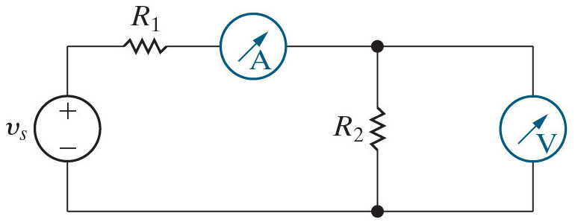
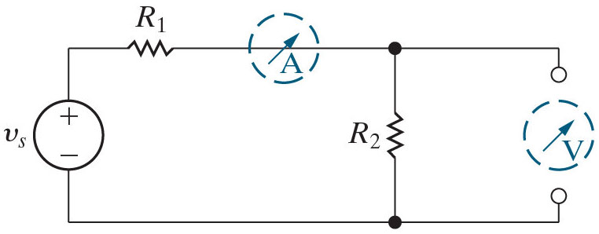


Chapter 3 – Simple resistive circuits (1 of 22)
Measuring current and voltage
An ammeter is an instrument that measures current. It is placed in series with the circuit element whose current is being measured. Ideally, the ammeter introduces no resistance in the circuit, so behaves like a short circuit.
A voltmeter is an instrument that measures voltage. It is placed in parallel with the circuit element whose voltage is being measured. Ideally, the voltmeter behaves like an open circuit.
An ammeter measuring
current and a
Models for an ideal ammeter and ideal voltmeter.
voltmeter measuring
voltage.

Slide 3
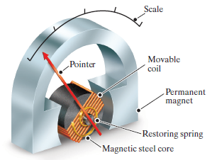
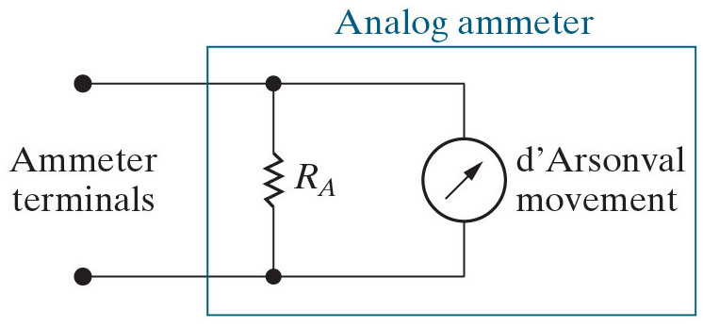
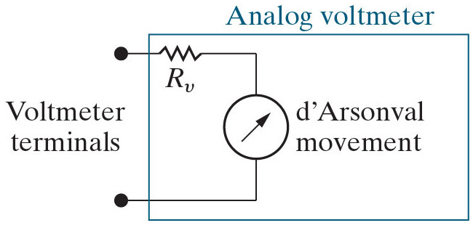
Chapter 3 – Simple resistive circuits (2 of 22)
Measuring current and voltage
Meters used in modern laboratories are usually digital. It is instructive, however, to examine analog meters, as they provide a practical application of the circuit analysis techniques we have introduced thus far.
Analog meters are based on the d’Arsonval meter movement. The moveable coil in the meter movement has both a voltage rating and a current rating. If a meter movement is rated at 50 m V and 1 m A, then when the coil carries 1 m A its voltage drop is 50 m V and the pointer deflects to its full-scale reading.

Slide 4
Chapter 3 – Simple resistive circuits (3 of 22)
Measuring current and voltage
The parallel resistor in the analog ammeter limits the current in the moveable coil (because of current division), while the series resistor in the analog voltmeter limits the voltage across the moveable coil (because of voltage division).
Analog meters are non-ideal. Both the added resistor and the meter movement introduce resistance in the circuit where the meter is attached. How much the meters alter the circuit being measured depends on the effective resistance of the meter compared with the resistance in the circuit.

Slide 5


Chapter 3 – Simple resistive circuits (4 of 22)
Measuring current and voltage – Example:
A 50 m V, 1m A D’Arsonval movement is used in a ammeter with a full-scale reading of 10 m A.
Find
Find the resistance that is added to a circuit when this ammeter is used to measure current.
The current in the ammeter divides between the
resistor and the meter
movement. When the current in the ammeter is 10 m A, the coil current is 1 m A and the resistor current is 9 m A. When the coil current is 1 m A, its voltage is 50 m V.

Slide 6

Chapter 3 – Simple resistive circuits (5 of 22)
When the coil current is 1 m A, its voltage is 50 m V. What is the
voltage across the
resistor?
A.
B. 50 V
C. 50 m V

Slide 7


Chapter 3 – Simple resistive circuits (5 of 22)
When the coil current is 1 m A, its voltage is 50 m V. What is the
voltage across the
resistor?
A.
B. 50 V
C. 50 m V

Slide 8
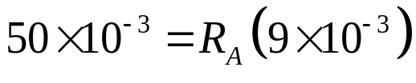
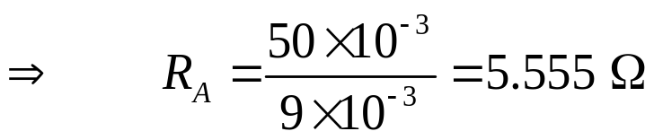
Chapter 3 – Simple resistive circuits (6 of 22)
Measuring current and voltage – Example (continued):
A 50 m V, 1m A D’Arsonval movement is used in a ammeter with a full-scale reading of 10 m A.
Find
Find the resistance that is added to a circuit when this ammeter is used to measure current.
From Ohm’s law,

Slide 9



Chapter 3 – Simple resistive circuits (7 of 22)
If a d’Arsonval meter movement is rated 50 m V and 1 m A, what is its resistance?
A.
B.
C.

Slide 10
Chapter 3 – Simple resistive circuits (7 of 22)
If a d’Arsonval meter movement is rated 50 m V and 1 m A, what is its resistance?
A.
B.
C.

Slide 11
Chapter 3 – Simple resistive circuits (8 of 22)
To find the effective resistance of the ammeter, combine the R A resistance and the d’Arsonval movement resistance in
A. series
B. parallel
C. These resistances cannot be combined

Slide 12
Chapter 3 – Simple resistive circuits (8 of 22)
To find the effective resistance of the ammeter, combine the R A resistance and the d’Arsonval movement resistance in
A. series
B. parallel
C. These resistances cannot be combined

Slide 13
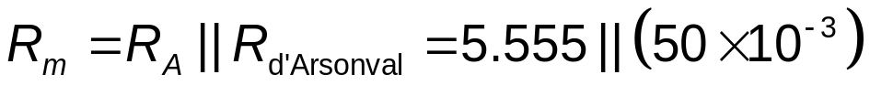

Chapter 3 – Simple resistive circuits (9 of 22)
Measuring current and voltage – Example (continued):
A 50 m V, 1m A D’Arsonval movement is used in a ammeter with a full-scale reading of 10 m A.
Find
Find the resistance that is added to a circuit when this ammeter is used to measure current.
The resistance of the ammeter is

Slide 14

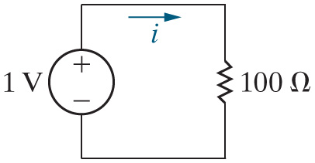
Chapter 3 – Simple resistive circuits (10 of 22)
If we want to measure the current i in the circuit shown here, we should
insert an ammeter in Fill in the blanks with the
resistor.
A. series
B. parallel
C. either series or parallel

Slide 15
Chapter 3 – Simple resistive circuits (10 of 22)
If we want to measure the current i in the circuit shown here, we should
insert an ammeter in Fill in the blanks with the
resistor.
A. series
B. parallel
C. either series or parallel

Slide 16

Chapter 3 – Simple resistive circuits (11 of 22)
If we insert an ideal ammeter in series with the
resistor,
what will the meter read?
A. 100 A
B. 1 m A
C. 10 m A

Slide 17
Chapter 3 – Simple resistive circuits (11 of 22)
If we insert an ideal ammeter in series with the
resistor,
what will the meter read?
A. 100 A
B. 1 m A
C. 10 m A

Slide 18


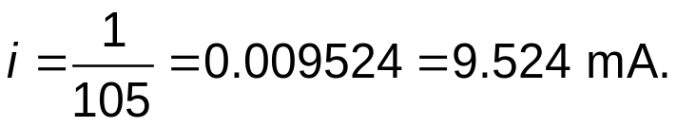
Chapter 3 – Simple resistive circuits (12 of 22)
Measuring current and voltage
Suppose we use the ammeter from the example to measure the current i in the circuit here. What will the ammeter read?
The resistance of the ammeter is
Since the ammeter is inserted in
series with the
resistor, the equivalent resistance seen by the 10 V
source is
Therefore,

Slide 19




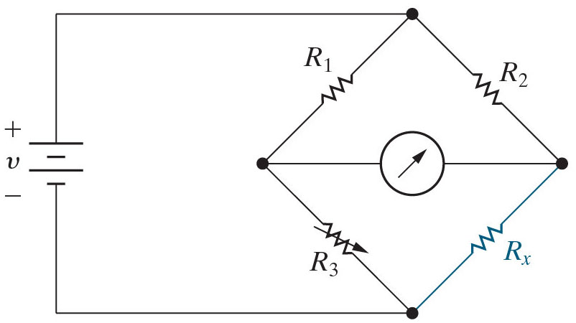


Chapter 3 – Simple resistive circuits (13 of 22)
Measuring resistance
An instrument that measures resistance is an ohmmeter. Many difference circuits can be used to measure resistance. Here we focus on the Wheatstone bridge. A Wheatstone bridge can accurately measure resistance in the range
of
to
A Wheatstone bridge consists of four resistors, a voltage source and a
detector, which is usually a d’Arsonval movement in the
range, called a
galvanometer.
The values of
and
are known.
is a variable resistor, called a
potentiometer, which can be set to a known value.
The value of
is unknown, and is
measured by the bridge circuit.

Slide 20


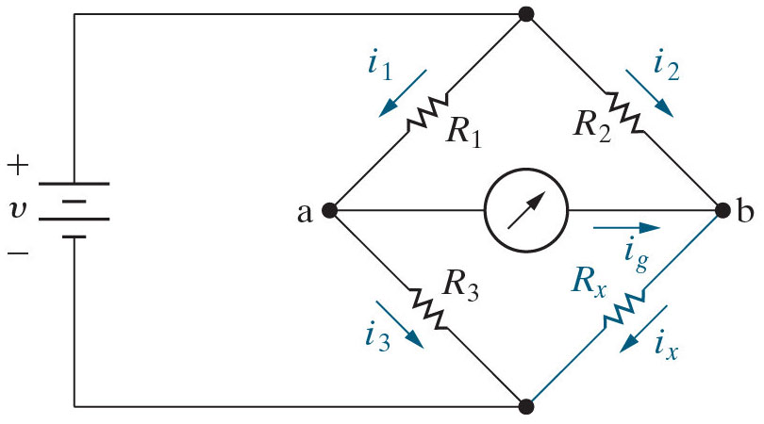
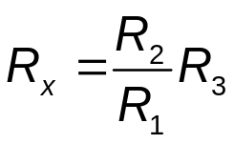


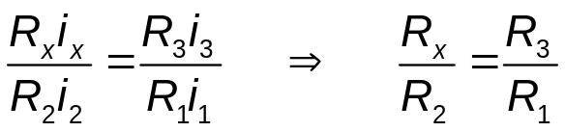
Chapter 3 – Simple resistive circuits (14 of 22)
Measuring resistance
To find the unknown resistance
adjust the
resistor until there is no current
in the galvanometer. Then the bridge is balanced and the unknown resistance is given by
When the galvanometer current is 0
K C L at node a:
K C L at node b:
K V L in lower mesh (clockwise):
K V L in upper mesh (clockwise):
divide the two K V L equations:
Notes:
Long Description:
Start Fraction R subscript x Baseline i subscript x Baseline over R subscript 2 Baseline i subscript 2 Baseline EndFraction equals Start Fraction R subscript 3 Baseline i subscript 3 Baseline over R subscript 1 Baseline i subscript 1 Baseline EndFraction, Forward arrow, Start Fraction R subscript x Baseline over R subscript 2 Baseline EndFraction equals Start Fraction R subscript 3 Baseline over R subscript 1 Baseline EndFraction.

Slide 21


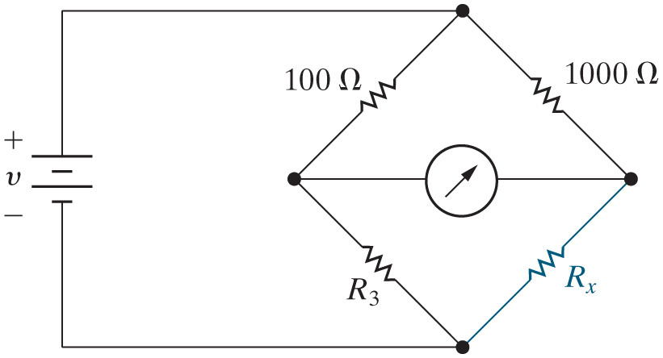



Chapter 3 – Simple resistive circuits (16 of 22)
The bridge circuit here is balanced when
What is the value of
A.
B.
C.

Slide 22
Chapter 3 – Simple resistive circuits (16 of 22)
The bridge circuit here is balanced when
What is the value of
A.
B.
C.

Slide 23
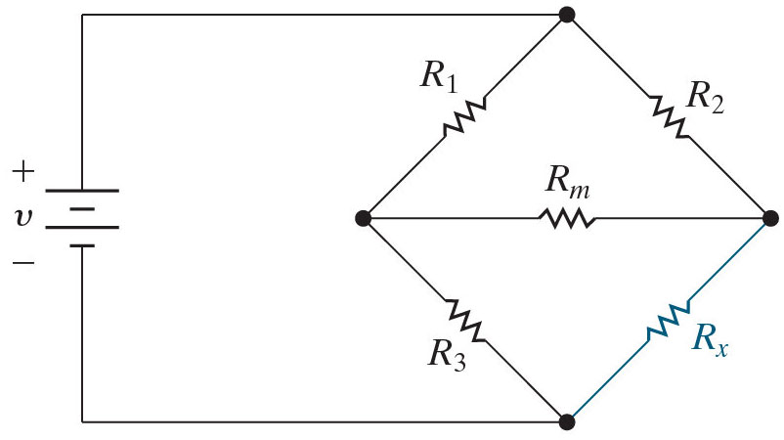


Chapter 3 – Simple resistive circuits (17 of 22)
Which statement is true about the resistors in this bridge circuit?
A.
and
are in series
B.
is in parallel with
and
C. There are no parallel-connected or series-connected resistors

Slide 24
Chapter 3 – Simple resistive circuits (17 of 22)
Which statement is true about the resistors in this bridge circuit?
A.
and
are in series
B.
is in parallel with
and
C. There are no parallel-connected or series-connected resistors

Slide 25
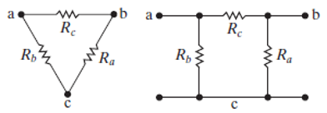
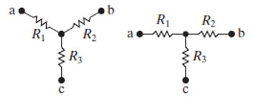


Chapter 3 – Simple resistive circuits (18 of 22)
Delta-to-Wye (Pi-to-Tee) Equivalent Circuits
While the bridge circuit has no series-connected or parallel-connected resistors, it does have resistors connected in a delta (or pi) configuration and resistors connected in a wye (or tee) configuration.
A
configuration rearranged to a
A Y configuration rearranged to a T

Slide 26






Chapter 3 – Simple resistive circuits (19 of 22)
Which statement is false about the resistors in this bridge circuit?
A.
are connected in a delta
B.
and
are connected in a wye
and
are connected in a delta
D.
and
are connected in a wye
E.
and
are connected in a wye

Slide 27
Chapter 3 – Simple resistive circuits (19 of 22)
Which statement is false about the resistors in this bridge circuit?
A.
are connected in a delta
B.
and
are connected in a wye
and
are connected in a delta
D.
and
are connected in a wye
E.
and
are connected in a wye

Slide 28
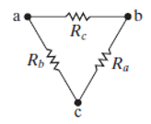
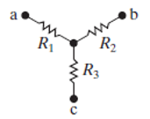

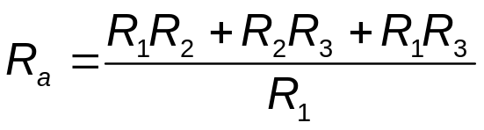
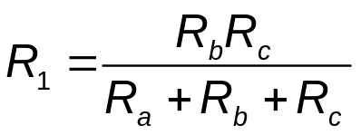
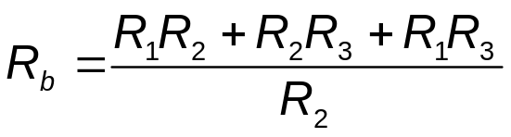
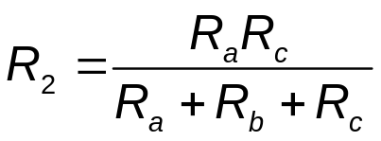
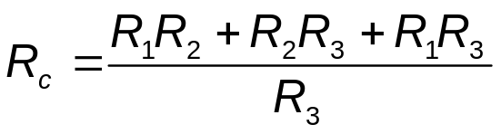
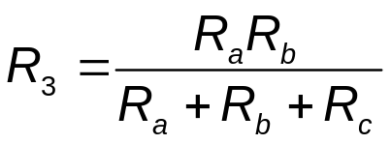
Chapter 3 – Simple resistive circuits (20 of 22)
Delta-to-Wye (Pi-to-Tee) Equivalent Circuits
A delta-connected configuration can be replaced by an equivalent wye-connected configuration, and vice versa.
Notes:
Long Description 1:
R subscript a Baseline equals Start Fraction R subscript 1 Baseline R subscript 2 Baseline plus R subscript 2 Baseline R subscript 3 Baseline plus R subscript 1 Baseline R subscript 3 Baseline over R subscript 1 Baseline End Fraction.
Long Description 2:
R subscript b Baseline equals Start Fraction R subscript 1 Baseline R subscript 2 Baseline plus R subscript 2 Baseline R subscript 3 Baseline plus R subscript 1 Baseline R subscript 3 Baseline over R subscript 2 Baseline End Fraction.
Long Description 3:
R subscript c Baseline equals Start Fraction R subscript 1 Baseline R subscript 2 Baseline plus R subscript 2 Baseline R subscript 3 Baseline plus R subscript 1 Baseline R subscript 3 Baseline over R subscript 3 Baseline End Fraction.
Long Description 4:
R subscript 1 Baseline equals Start Fraction R subscript b Baseline R subscript c Baseline over R subscript a Baseline plus R subscript b Baseline plus R subscript c Baseline End Fraction.
Long Description 5:
R subscript 2 Baseline equals Start Fraction R subscript a Baseline R subscript c Baseline over R subscript a Baseline plus R subscript b Baseline plus R subscript c Baseline End Fraction.
Long Description 6:
R subscript 3 Baseline equals Start Fraction R subscript a Baseline R subscript b Baseline over R subscript a Baseline plus R subscript b Baseline plus R subscript c Baseline End Fraction.

Slide 29
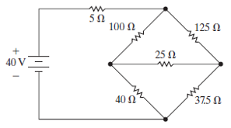
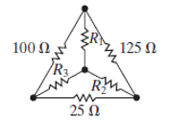
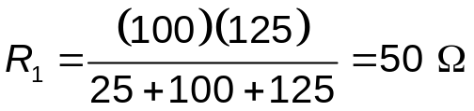
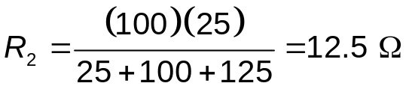
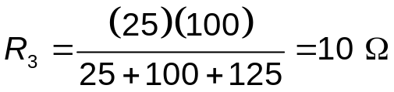
Chapter 3 – Simple resistive circuits (21 of 22)
Delta-to-Wye (Pi-to-Tee) Equivalent Circuits – Example:
For the circuit shown here, find the current in the voltage source.
To do this, find the equivalent resistance seen by the voltage source. Start by replacing the upper delta with its equivalent wye.

Slide 30
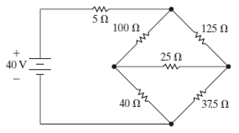
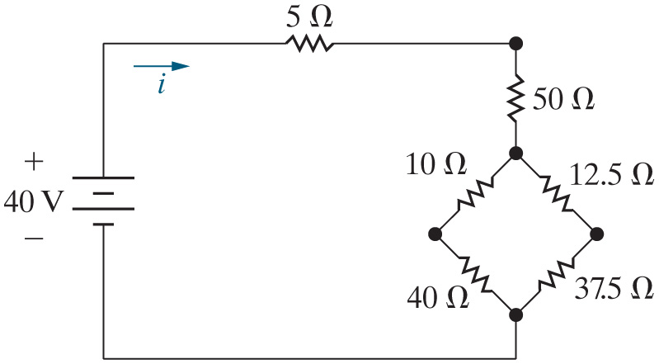


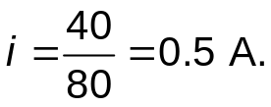
Chapter 3 – Simple resistive circuits (22 of 22)
Delta-to-Wye (Pi-to-Tee) Equivalent Circuits – Example (continued):
For the circuit shown here, find the current in the voltage source.
The equivalent resistance seen by the source is
Therefore, the current in the voltage source is
Notes:
Long Description:
R subscript eq Baseline equals 5 plus 50 plus Open Square Bracket Open Parenthesis 10 plus 40 Close Parenthesis parallel to Open Parenthesis 12.5 plus 37.5 Close Parenthesis Close Square Bracket equals 5 plus 50 plus Open Square Bracket 50 parallel to 50 Close Square Bracket.

Slide 31
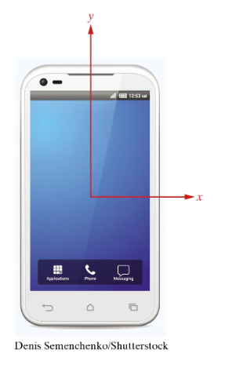
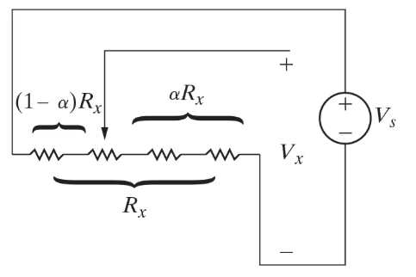
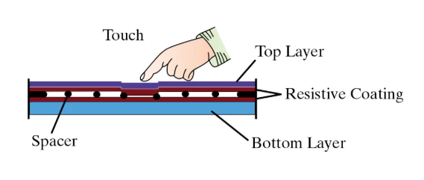
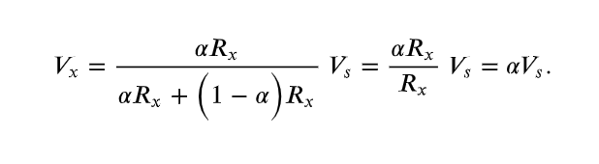
Chapter 3 – Simple resistive circuits
Notes:
Long Description:
R subscript eq Baseline equals 5 plus 50 plus Open Square Bracket Open Parenthesis 10 plus 40 Close Parenthesis parallel to Open Parenthesis 12.5 plus 37.5 Close Parenthesis Close Square Bracket equals 5 plus 50 plus Open Square Bracket 50 parallel to 50 Close Square Bracket.

Slide 32
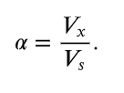
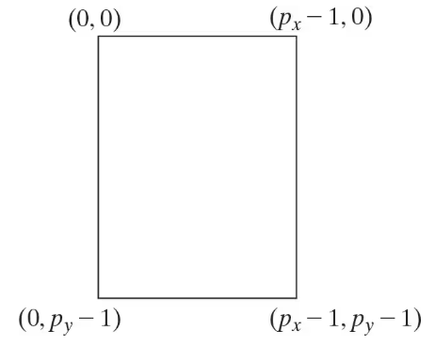

Chapter 3 – Simple resistive circuits
Notes:
Long Description:
R subscript eq Baseline equals 5 plus 50 plus Open Square Bracket Open Parenthesis 10 plus 40 Close Parenthesis parallel to Open Parenthesis 12.5 plus 37.5 Close Parenthesis Close Square Bracket equals 5 plus 50 plus Open Square Bracket 50 parallel to 50 Close Square Bracket.

Slide 33
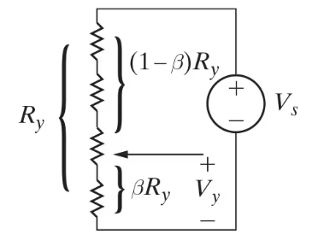


Chapter 3 – Simple resistive circuits
Notes:
Long Description:
R subscript eq Baseline equals 5 plus 50 plus Open Square Bracket Open Parenthesis 10 plus 40 Close Parenthesis parallel to Open Parenthesis 12.5 plus 37.5 Close Parenthesis Close Square Bracket equals 5 plus 50 plus Open Square Bracket 50 parallel to 50 Close Square Bracket.

